Slide 1
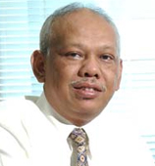
DEMOCRACY AND RELIGIO-CULTURAL PLURALISM IN INDONESIA; Pancasila and Politics of Multiculturalism
Azyumardi Azra, CBE
Presented at Public Lecture
‘Indonesia, Islam dan Demokrasi:
Dinamika dalam Politik Indonesia Kontemporer’
Fisip Unand, Padang 22 April, 2019

Slide 2
Modern Indonesian State
Indonesia gained its independence on Aug 17, 1945 following the end of World War II; Indonesia was occupied by the Japanese in 1942 to 1945 after the eviction of the Dutch;
Geographically Indonesia consist of more than 17.000 islands and some 300 ethnic groups who speak different languages and have distinctive socio-cultural traditions. The geography of the Republic is the area that was colonialized by the Dutch;
Bulk majority (88,7 per cent) of Indonesia’s population is Muslim. But neither is Indonesia an Islamic state nor is Islam the official religion of the state;
There are now six religions recognized by the state: Islam, Protestanism, Catholicism, Hinduism, Buddhism, and Confucianism.
Since first cabinet after independence (1945), Indonesian state has Ministry of Religious Affairs, managing socio-religious lives of the nation.

Slide 3
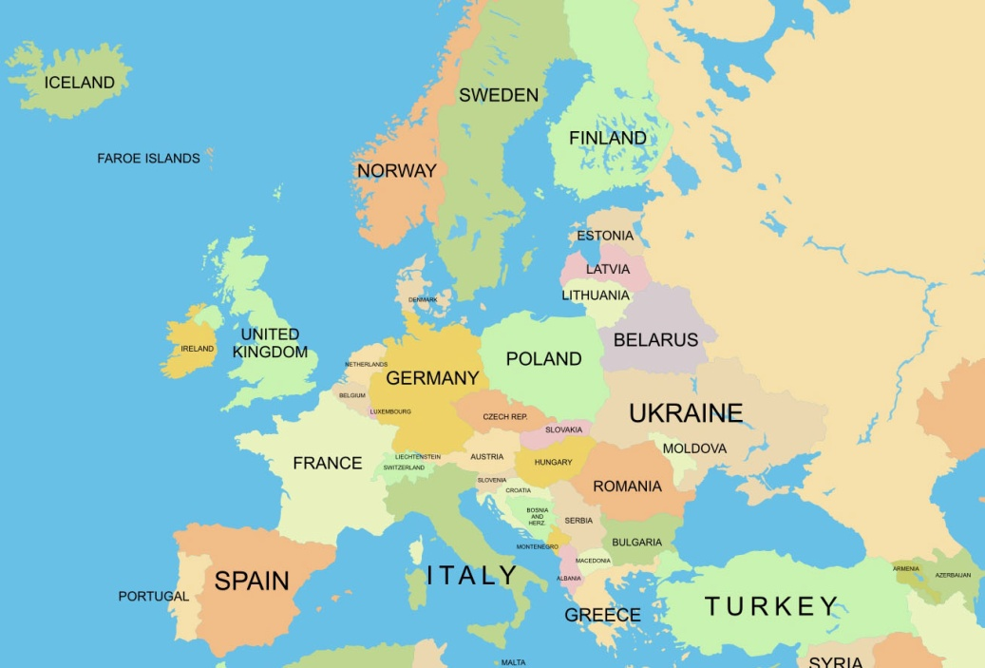
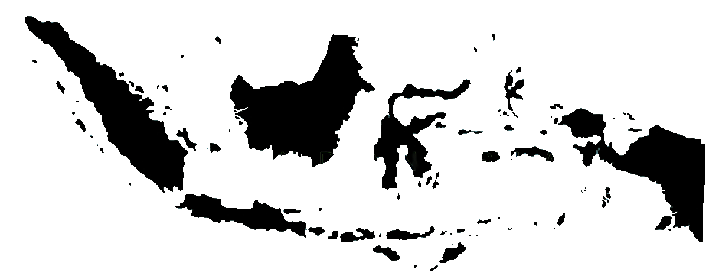

Slide 4
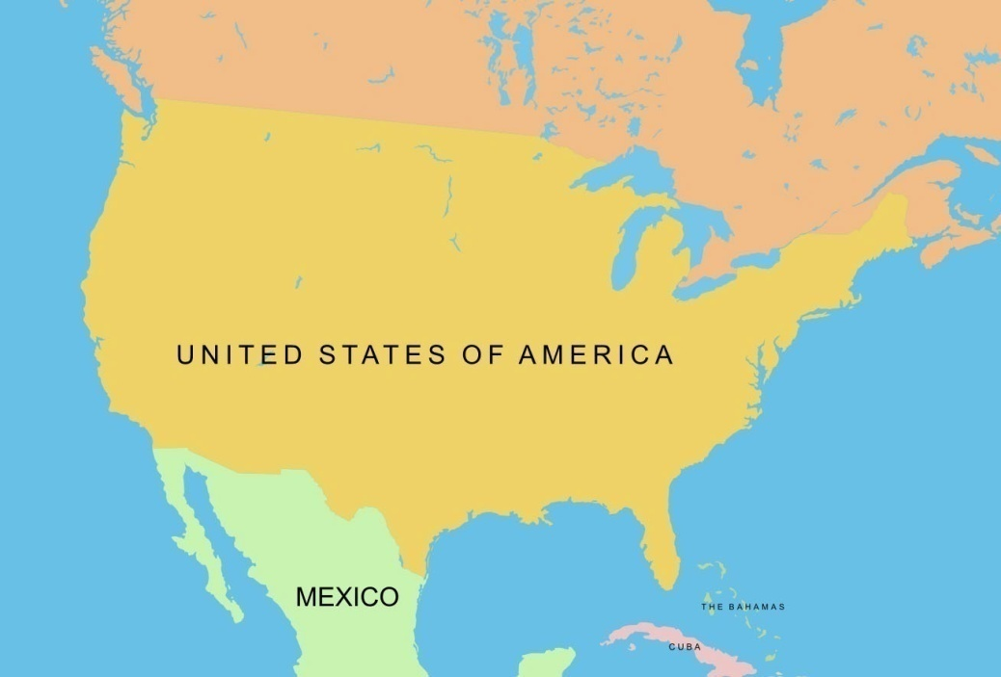

Slide 5
Basic Features of Indonesian Politics
Indonesia since 1999 is the third largest democracy after India and USA;
Indonesia is the fourth most populated country;
Indonesia is the largest Muslim country; where Islam and democracy go hand in hand; Islam is compatible with democracy
Indonesian democracy still needs to be consolidated further;
Indonesia takes a leading role in the disemmination of democracy through Bali Democracy Forum (BDF)—10 years on.

Slide 6
Indonesian Three Kinds of Democracy
Liberal, multi-party democracy—post-independence and election 1955;
‘Guided democracy’ 1959-1965 under ‘Old Order’ President Soekarno with three Nasakom parties (PNI, PKI, PNU);
‘Pancasila Democracy 1971-1998, under New Order President Soeharto, with three parties (Golkar, PDI, and PPP) with elections in 1971, 1977, 1982, 1987, 1992, and 1997;
Liberal, multi-party democracy, reform period, with elections in 1999, 2004, 2009, 2014, and 2019.

Slide 7
Post-Soeharto Democracy
Basically ‘liberal democracy’, multi-party politics;
Religious-based parties (Islam/PPP, PKS, PBB and Christianity/PDS), and Pancasila-based parties/P Golkar, PDIP, PD, PKB, PAN;
Post-Soeharto elections: 1999, 2004, 2009, 2014, and 2019.
The winners of legislature elections: PDIP (1999), Golkar Party (2004), Democrat Party (2009), PDIP (9 April 2014), and PDIP (17 April 2019)—all are not Islamic-based political party, thus basically there is no ‘Islamic identity politics’ in Indonesia.

Slide 8
Indonesian Islam and Democracy
Indonesian Muslims accept democracy since the time of independence;
Indonesian Muslims in general view that Islam is compatible with democracy;
Indonesian Muslims participated in all stages of Indonesian democracy;
Muslim women have increasingly occupied legislature bodies, and executive offices from Presidency (Megawati Soekarnoputri 2001-4), governors, and mayors/district chiefs.

Slide 9
Mainstream Islam and Democracy
Mainstream Indonesia Islam consists of large organizations; Nahdlatul Ulama (NU, est 1926), Muhammadiyah (est 1912), and some other smaller organizations across the country.
They are also religious-based Civil Society (CS) organizations. They are inclusive, accepting multiculturalism;
These organizations are religious-based Civil Society playing: instrumental role in growing and strengthening ‘civic culture’ and ‘civility’, crucial for democracy to grow; maintenance of social cohesion; and provision of alternative socio-political leadership;
Islam/Muslims are important factors in Indonesian politics.

Slide 10
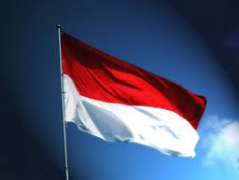
Indonesian State, Pancasila and Multiculturalism
Indonesia is based on Pancasila (‘Five Pillars’): Belief in One Supreme God, Just and Civilized Humanity, Indonesian Unity, Democracy based on Representation and Deliberation, and Social Justice for all Indonesian people;
With Pancasila as the basis, Indonesian State is not a ‘confessional’ state, nor is it a ‘purely’ secular state. Religious life is part and parcel of public life;
Pancasila is a ‘religiously friendly’ basis of the Indonesian state;
Freedom of religion is guaranteed by Article 29 of the 1945 Indonesian Constitution ;
Pancasila is a politics of recognition—multiculturalism;
Bhinneka Tunggal Ika (Unity in Diversity), another fundamental principle of Indonesian State, is also the basis of politics of multiculturalism.

Slide 11
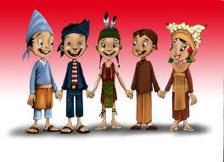
Politics of Multiculturalism (1)
Any Indonesian can occupy public office regardless religion and ethnicity;
National language is Bahasa Indonesia (adopted on 28 October 1928); but local/ethnic languages are maintained;
National culture is promoted; but local tradition/customs are celebrated;
Increased contact and interaction strenghten the feeling of Indonesianness.

Slide 12
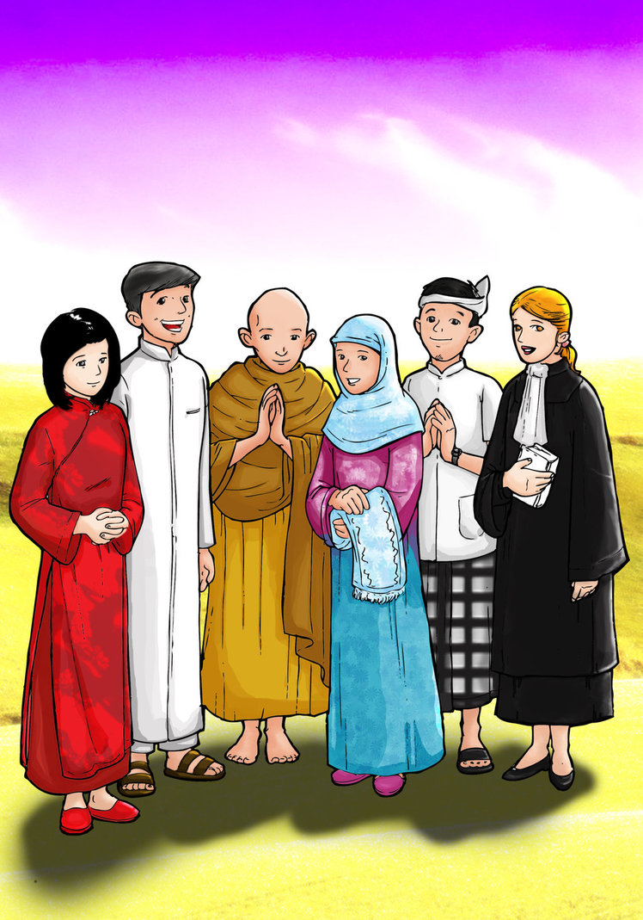
Politics of Multiculturalism (2)
Religious special days of the six recognized religions are officially recognized and celebrated as national holidays;
Each community of the believers have own council, representing them in inter-faith dialogues from national to local levels;
Religious instruction is mandatory in schools with teachers of the same religion with students.

Slide 13
Indonesian Islam
Islam was introduced mostly by Sufi wandering teachers since 12th century on—penetration pacifique and accommodation of local culture—embedded;
Indonesia is now the largest Muslim nation in the world; 88.7 per cent out of 238 million of its population is Muslim; Indonesia is also the third largest democracy after India and USA;
Indonesian Islam is a moderate and ‘wasatiyyah Islam’—middle path Islam with strong tradition of inclusiveness, tolerance and peaceful co-existence with adherents of other religions;
Indonesian Islam is the least Arabicized Muslim country; but no less Islamic;
Indonesian Islam provides much greater freedom to Muslim women in religious, social, cultural and political lives.

Slide 14
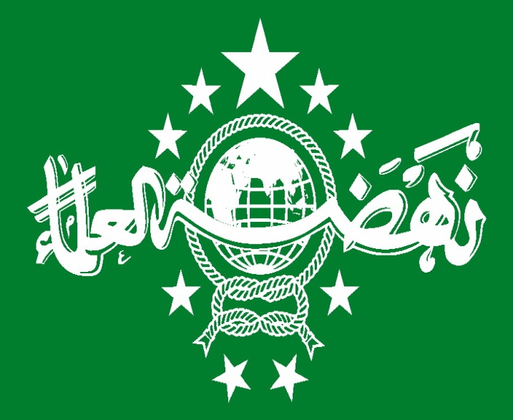
Mainstream Islam:
Mainstream Indonesia Islam consists of large organizations; Nahdlatul Ulama (NU, est 1926), Muhammadiyah (est 1912), and some other smaller organizations across the country;
They are also represent religious-based Civil Society organizations—independent from state, self- regulating, self financing;
They are crucial in strengthening civic culture and civility—crucial for democracy to root, to maintain social cohesion and to provide ‘alternative leadership’ in time of crisis;
They play an important role in education, Islamic preaching; health services; philanthropy endeavors;
They are active in intra (among Muslims) and inter-faith dialogues (with non-Muslims);

Slide 15
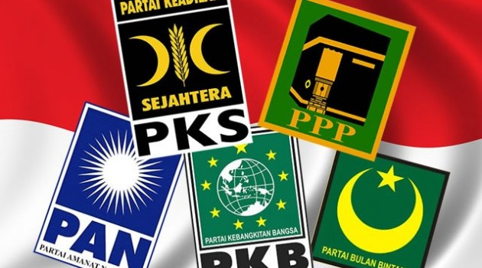
Indonesian Islam and Politics:
Indonesian Muslim have accepted democracy since the time of independence; and there is no problem between Islam and democracy both at conceptual and practical levels;
The so-called theory ‘Democracy Trap’—the Islamists use democracy for their own purposes such in Arab countries—is not relevant to Indonesia;
There are some Islamic-based parties that contested election of 1999, 2004, 2009, 2014 and 2019. But they fared poorly;
Muslims cast their votes for non-Islamic-oriented parties that won elections; they were PDIP (1999), Golkar (2004), Partai Demokrat (2009), and PDIP (2014 and 2019).

Slide 16
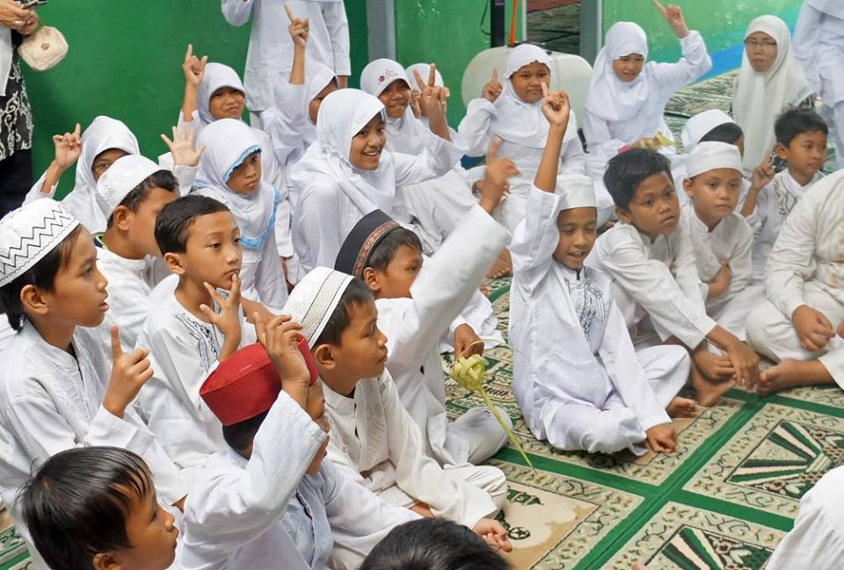
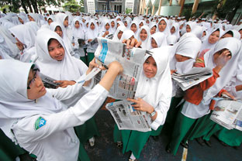
New Trends of Indonesian Islam:
*The rise of Muslim middle class thanks to the improvement of Indonesian economy and education;
*Muslim middle class becomes back-bone of the rise of quality Islamic school, Islamic relief and other kinds of Islamic philantropy;
*Islamic attachment is gaining ground indicated by widespread use of hijab (jilbab, simple veil) by Muslim women, increased number of Muslims going for haj and umrah (lesser pilgrimage) to Mecca and Medina;
*Rise of Islamic attachment does not have any effect on Indonesian politics; it does not affect the future of a ‘secular’ Indonesia.

Slide 17
Role of Indonesian Islam:
Indonesian Islam can play an important role in the Muslim world through disemmination of moderate understanding of Islam.
Indonesian Islam can also show the Muslim of how Islam and democracy can be compatible and as the best political system for all.
Indonesian Islam can play a mediating force in the creation of peace in the Muslim world, particularly in the Middle East.

